Slide 1
IoT Architecture
IoT architecture is the system of numerous elements: sensors, protocols, actuators, cloud services, and layers. Given its complexity, there exist 4 stages of IoT architecture.
Internet of Things architecture layers are distinguished in order to track the consistency of the system

Slide 2
IoT Architecture
Basically, there are three IoT architecture layers:
1. The client side (IoT Device Layer)
2. Operators on the server side (IoT Getaway Layer)
3. A pathway for connecting clients and operators (IoT Platform Layer)
Addressing the needs of all these layers is crucial on all the stages of IoT architecture

Slide 3
IoT Architecture
In addition, the fundamental features of sustainable IoT architecture include functionality, scalability, availability, and maintainability. Without addressing these conditions, the result of IoT architecture is a failure.

Slide 4
IoT Architecture
Therefore, all the above-mentioned requirements are addressed in 4 stages of IoT architecture.

Slide 5
An Overview of the Main Stages in the IoT
The 4 Stage IoT architecture consists of
1. Sensors and actuators
2. Internet gateways and Data Acquisition Systems
3. Edge IT
4. Data center and cloud.

Slide 6
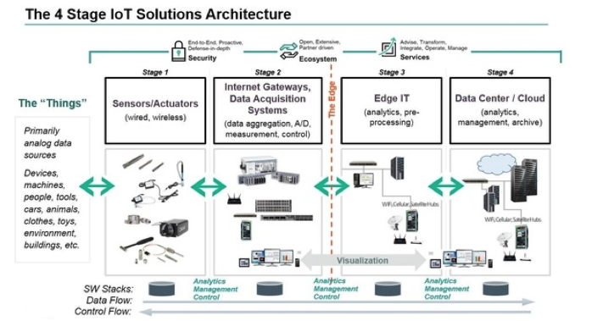
An Overview of the Main Stages in the IoT Architecture Diagram

Slide 7
An Overview of the Main Stages in the IoT
Stage 1. Networked things (wireless sensors and actuators)
The outstanding feature about sensors is their ability to convert the information obtained in the outer world into data for analysis.
to get information in an appearance that can be actually processed.

Slide 8
An Overview of the Main Stages in the IoT
For actuators, the process goes even further — these devices are able to intervene the physical reality. For example, they can switch off the light and adjust the temperature in a room.

Slide 9
Stage 1
sensing and actuating stage covers and adjusts everything needed in the physical world to gain the necessary insights for further analysis.

Slide 10
An Overview of the Main Stages in the IoT
Stage 2. Sensor data aggregation systems and analog-to-digital data conversion
Even though this stage of IoT architecture still means working in a close proximity with sensors and actuators,
Internet getaways and data acquisition systems (DAS) appear here too. Specifically, the later connect to the sensor network and aggregate output, while Internet getaways work through Wi-Fi, wired LANs and perform further processing.

Slide 11
Stage 2
The vital importance of this stage is to process the enormous amount of information collected on the previous stage and squeeze it to the optimal size for further analysis. Besides, the necessary conversion in terms of timing and structure happens here.
In short, Stage 2 makes data both digitalized and aggregated.

Slide 12
An Overview of the Main Stages in the IoT
Stage 3. The appearance of edge IT systems
During this moment among the stages of IoT architecture, the prepared data is transferred to the IT world. In particular, edge IT systems perform enhanced analytics and pre-processing here. For example, it refers to machine learning and visualization technologies. At the same time, some additional processing may happen here, prior to the stage of entering the data center.

Slide 13
An Overview of the Main Stages in the IoT
Stage 4. Analysis, management, and storage of data
The main processes on the last stage of IoT architecture happen in data center or cloud. Precisely, it enables in-depth processing, along with a follow-up revision for feedback. Here, the skills of both IT and OT (operational technology) professionals are needed.

Slide 14
Stage 5 of IoT Architecture?
In fact, there is an option to extend the process of building a sustainable IoT architecture by introducing an extra stage in it.
It refers to initiating a user’s control over the structure — if only your result doesn’t include full automation, of course.
The main tasks here are visualization and management. After including Stage 5, the system turns into a circle where a user sends commands to sensors/actuators (Stage 1) to perform some actions.

Slide 15
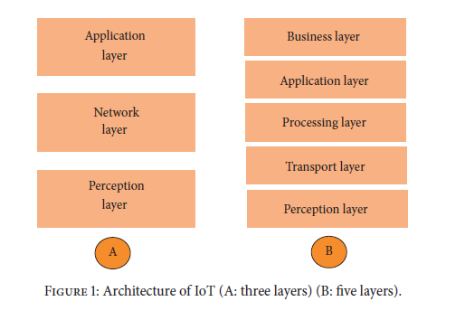
IoT architecture(layered)

Slide 16
(i) The perception layer is the physical layer, which has
sensors for sensing and gathering information about
the environment. It senses some physical parameters
or identifies other smart objects in the environment.
(ii) The network layer is responsible for connecting to
other smart things, network devices, and servers. Its
features are also used for transmitting and processing
sensor data.
(iii) The application layer is responsible for delivering
application specific services to the user. It defines
various applications in which the Internet of Things
can be deployed, for example, smart homes, smart
cities, and smart health.

Slide 17
(i) The transport layer transfers the sensor data from
the perception layer to the processing layer and vice
versa through networks such as wireless, 3G, LAN,
Bluetooth, RFID, and NFC.
(ii) The processing layer is also known as the middleware
layer. It stores, analyzes, and processes huge amounts
of data that comes from the transport layer. It can
manage and provide a diverse set of services to the
lower layers. It employs many technologies such as
databases, cloud computing, and big data processing
modules.

Slide 18
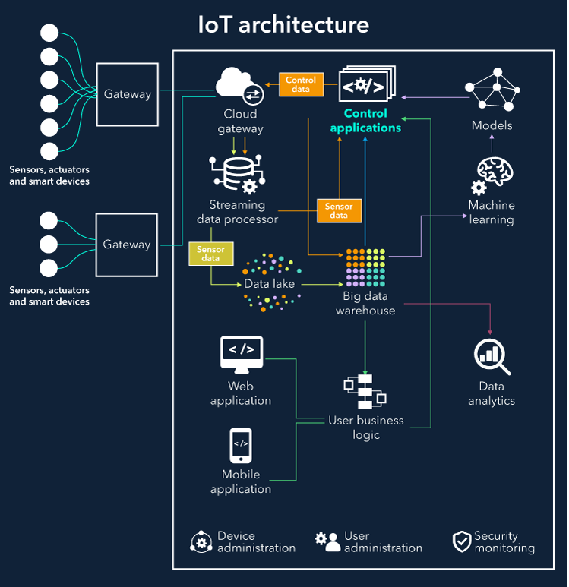
Basic elements of IoT architecture

Slide 19
Basic elements of IoT architecture
IoT architecture diagram which shows the building blocks of an IoT system and how they are connected to collect, store and process data.
Things. A “thing” is an object equipped with sensors that gather data which will be transferred over a network and actuators that allow things to act (for example, to switch on or off the light, to open or close a door, to increase or decrease engine rotation speed and more). This concept includes fridges, street lamps, buildings, vehicles.
Sensors are not in all cases physically attached to the things: sensors may need to monitor, for example, what happens in the closest environment to a thing.

Slide 20
Basic elements of IoT architecture
Gateways. Data goes from things to the cloud and vice versa through the gateways.
A gateway provides connectivity between things and the cloud part of the IoT solution, enables data preprocessing and filtering before moving it to the cloud (to reduce the volume of data for detailed processing and storing) and transmits control commands going from the cloud to things. Things then execute commands using their actuators.

Slide 21
Basic elements of IoT architecture
Cloud gateway facilitates data compression and secure data transmission between field gateways and cloud IoT servers.
It also ensures compatibility with various protocols and communicates with field gateways using different protocols depending on what protocol is supported by gateways.

Slide 22
Basic elements of IoT architecture
Streaming data processor ensures effective transition of input data to a data lake and control applications. No data can be occasionally lost or corrupted.
Data lake. A data lake is used for storing the data generated by connected devices in its natural format. Big data comes in "batches" or in “streams”. When the data is needed for meaningful insights it’s extracted from a data lake and loaded to a big data warehouse.

Slide 23
Basic elements of IoT architecture
Big data warehouse. Filtered and preprocessed data needed for meaningful insights is extracted from a data lake to a big data warehouse. A big data warehouse contains only cleaned, structured and matched data (compared to a data lake which contains all sorts of data generated by sensors). Also, data warehouse stores context information about things and sensors (for example, where sensors are installed)

Slide 24
Basic elements of IoT architecture
Data analytics. Data analysts can use data from the big data warehouse to find trends and gain actionable insights. When analyzed (and in many cases – visualized in schemes, diagrams, infographics) big data show, for example, the performance of devices, help identify inefficiencies and work out the ways to improve an IoT system (make it more reliable, more customer-oriented).

Slide 25
Basic elements of IoT architecture
Machine learning and the models ML generates. With machine learning, there is an opportunity to create more precise and more efficient models for control applications. Models are regularly updated (for example, once in a week or once in a month) based on the historical data accumulated in a big data warehouse. When the applicability and efficiency of new models are tested and approved by data analysts, new models are used by control applications.

Slide 26
Basic elements of IoT architecture
Control applications send automatic commands and alerts to actuators, for example:
Windows of a smart home can receive an automatic command to open or close depending on the forecasts taken from the weather service.
When sensors show that the soil is dry, watering systems get an automatic command to water plants.

Slide 27
Basic elements of IoT architecture
Control applications can be either rule-based or machine-learning based.
In the first case, control apps work according to the rules stated by specialists.
In the second case, control apps are using models which are regularly updated (once in a week, once in a month depending on the specifics of an IoT system) with the historical data stored in a big data warehouse

Slide 28
Rule based
IF-THEN Rules
Rule-based classifier makes use of a set of IF-THEN rules for classification. We can express a rule in the following form −
IF condition THEN conclusion
R1: IF age = youth AND student = yes THEN buy_computer = yes
Points to remember −
The IF part of the rule is called rule antecedent or precondition.
The THEN part of the rule is called rule consequent.
The antecedent part the condition consist of one or more attribute tests and these tests are logically ANDed.
The consequent part consists of class prediction.

Slide 29
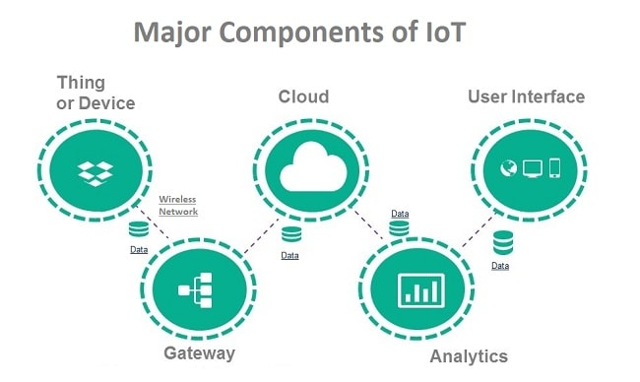
What are the major components of Internet of Things

Slide 30
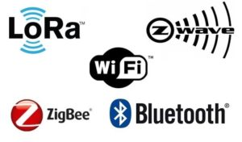
Common sensors are:
Temperature sensors and thermostats
Pressure sensors
Humidity / Moisture level
Light intensity detectors
Moisture sensors
Proximity detection
RFID tags
How the devices are connected?
Most of the modern smart devices and sensors can be connected to low power wireless networks like Wi-Fi, ZigBee, Bluetooth, etc. Each of these wireless technologies has its own pros and cons in terms of power, data transfer rate and overall efficiency.

Slide 31
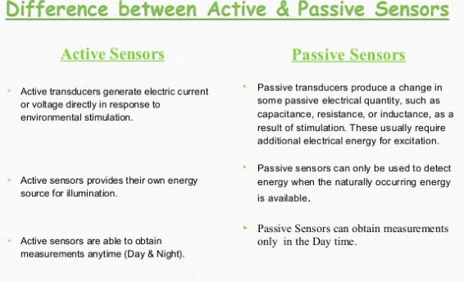
IoT sensors which are used for temperature, pressure, Inertia, humidity, proximity, gesture, touch and fingerprint sensing applications. These sensors are based on MEMS technology. MEMS is the short form of Micro Electro-Mechanical Systems.

Slide 32
Device management
To ensure sufficient functioning of IoT devices, it’s far not enough to install them and let things go their way.
There are some procedures required to manage the performance of connected devices (facilitate the interaction between devices, ensure secure data transmission and more)

Slide 33
Device identification to establish the identity of the device to be sure that it’s a genuine device with trusted software transmitting reliable data.
Configuration and control to tune devices according to the purposes of an IoT system. Some parameters need to be written once a device is installed (for example, unique device ID). Other settings might need updates (for example, the time between sending messages with data).
Monitoring and diagnostics to ensure smooth and secure performance of every device in a network and reduce the risk of breakdowns.
Software updates and maintenance to add functionality, fix bugs, address security vulnerabilities.

Slide 34
User management
Alongside with device management, it’s important to provide control over the users having access to an IoT system.
User management involves identifying users, their roles, access levels and ownership in a system. It includes such options as adding and removing users, managing user settings, controlling access of various users to certain information, as well as the permission to perform certain operations within a system, controlling and recording user activities and more.

Slide 35
Security monitoring
Connected things produce huge volumes of data, which need to be securely transmitted and protected from cyber-criminals.
To prevent such problems, it makes sense to log and analyze the commands sent by control applications to things, monitor the actions of users and store all these data in the cloud. With such an approach, it’s possible to address security breaches at the earlies stages.

